Slide 1


Ellipsis Tech Series Hackathon
StockOverflow: Building a Financial Future for Youths
First steps to a sustainable investment process
Before
Lack appreciation of long-term financial goals
Lack awareness of personal risk profile
Lack information on asset allocation
After
Track key financial milestones
Understand personal risk profile
Provide recommended asset allocation
Aid in research and execution of investment plans
Team Members:
Ong Kang Wei
Kenny Pang
Tammi Chng
Wa Thone
Yar Khine Phyo
Date:
7 September 2020
School:
Singapore Management University
1
1
1
1
1
1
2
3
4
5
Proposed Solution
Business Case
Solution Architecture
Technology/Framework
Solution Demo
Notes:
Script:
Modern day youths are bombarded with a large amount of information and finds it increasing difficult to make sense of them. To start out with an apt investment plan for retirement is becoming increasingly complicated as useful information gets mixed with the rest. Besides the lack of financial knowledge, the lack of a clear direction in properly setting up an investment plan has caused many to fall into the pitfall of short-term trading without first understanding what they are investing in. We want to step in to be the guiding platform for youths to follow a proper, professional structure when it comes to investing their money.

Slide 2
Overview of Proposed Solution
Our objective is to make the process of financial planning more seamless and lower the informational barriers that exist in investing.
Establishing Financial Milestones & Retirement Sum
Recommend Portfolio Mix based on Risk Assessment Results
Individual Stock Dashboard with Condensed Data
Better picture of future financial requirements as they reach key milestones in life
Compute an estimated amount required for retirement
Low Risk
Medium Risk
High Risk
Besides quality score, dashboard incorporates valuable proprietary features like a short term social media sentiment indicator
Conservative
Moderate
Aggressive
01
02
03
04
05
Risk Assessment Survey
Text
Text
Text
Text
Text
Text
Text
Text
Text
Text
Text
Text
Text
Text
Text
Text
Text
Text
Text
Text
Text
Text
Text
Text
Text
Text
Text
Text
Text
Text
Text
Text
Text
Text
Text
Text
Text
Text
Text
Text
Text
Text
Text
Text
Text
Text
Better understand willingness and ability to take risks
Recommend portfolio mix that abides to individual’s risk profile to aid in decisions when exposed to rising or falling share prices
1
Stock’s Quality Score
Four guiding metrics
2
4
3
Notes:
Our platform, stockoverflow, seeks to create a systematic structure for new investors to understand both personal financial requirements going into adulthood, and their retirement sum needed. Based on a risk assessment survey, we recommend a portfolio mix consisting of stocks and bonds. And from there, based on a set of fundamental metrics derived, we allocate a quality score for stocks in a summarised dashboard help determine the attractiveness of companies. We also included a sentiment indicator to measure real time a stock’s sentiment on social media.

Slide 3
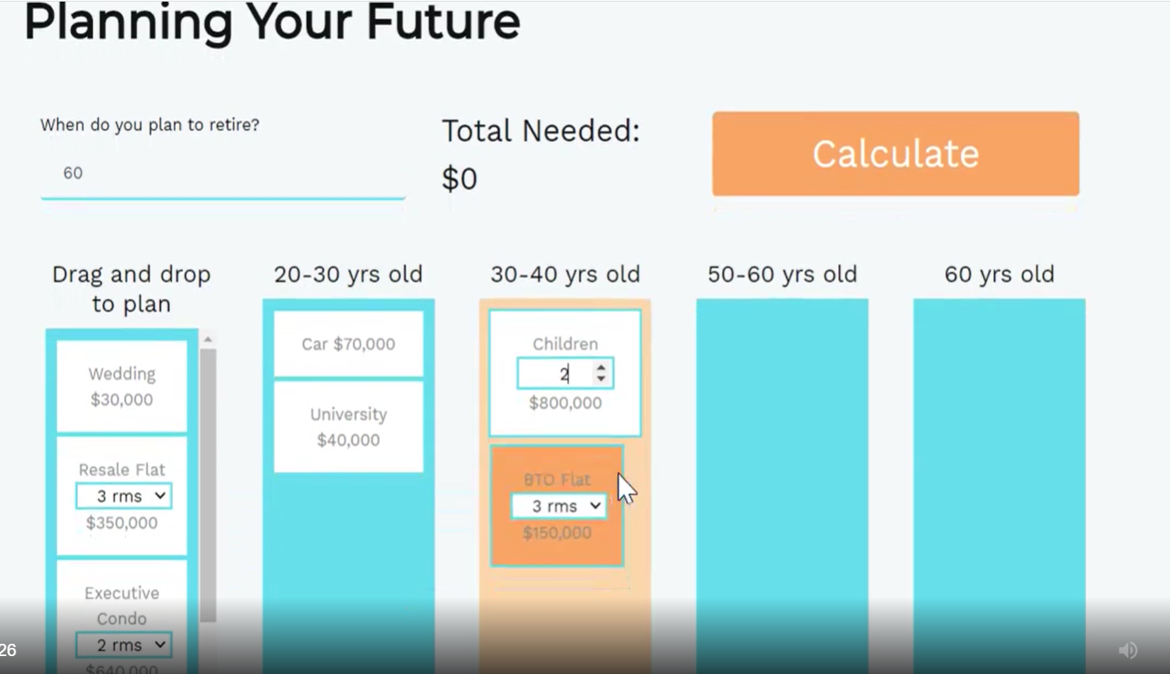



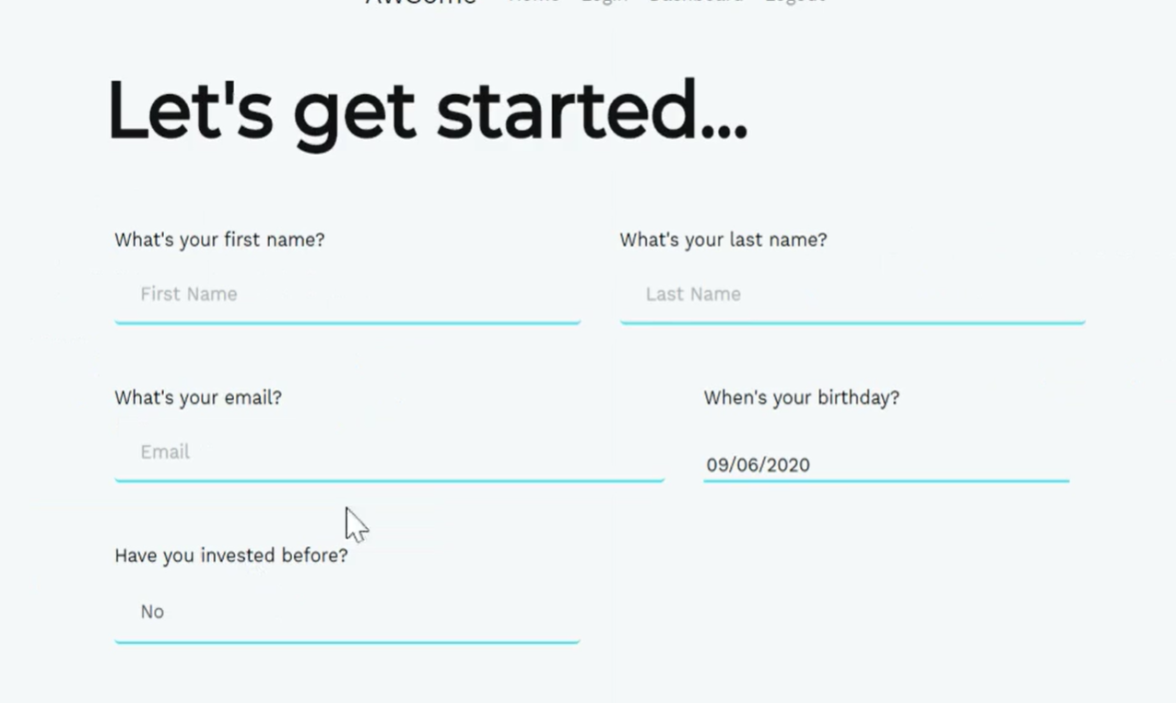
Detailed Analysis of Solution
The system automatically calculates expected monthly contributions based on the risk assessment survey and retirement plan inputs.
Risk Assessment
Retirement Plan and Expected Contributions
Understanding risk tolerance is essential for investment success
Key factors include:
Users are asked to estimate their expected expenditure in retirement
Expected returns are estimated based on historical returns and volatility of the various asset classes
Years to Withdrawal
Ability to Endure Losses
Aversion to Losses
Based on Historical Returns and Volatility
% Allocation Depends On Risk Assessment Results
Stocks 80Y CAGR: +7.24%
Stocks Yearly Vol: 15.61%
Current Savings Bond Yield: 0.95%
Based on these figures, we compute an estimate of the monthly deposit needed to achieve their target retirement
Best Case
Base Case
Worst Case
100% Bond Allocation
100% Stock Allocation
Years
Reduces the chance of premature withdrawal and subpar returns
Using historical returns and volatility as a benchmark, we propose a range of possible returns with 80% confidence
Notes:
Lets move on to a detailed analysis of our solutions. We begin first with a risk assessment survey, which contains five questions that touches such as years to withdrawal, ability to endure drawdowns and aversion to losses.
Based on the results of this survey, we recommend a portfolio allocation, which ranges from a full allocation to low-risk assets like bonds to a full allocation to high-risk assets like stocks.
Following this, we move on to the retirement plan. In this segment, users are asked to estimate their expected retirement expenditure by approximating their monthly expenditure and the expected duration of their retirement.
We then proceed to compute an estimate of the monthly deposit required to achieve that target requirement, based on the earlier portfolio allocation and the historical returns by asset class.
However, we know that investment returns are rarely guaranteed, so we will also display a chart showing the range of possible returns given an 80% confidence level, which gives the user a better idea of the risk involved.

Slide 4
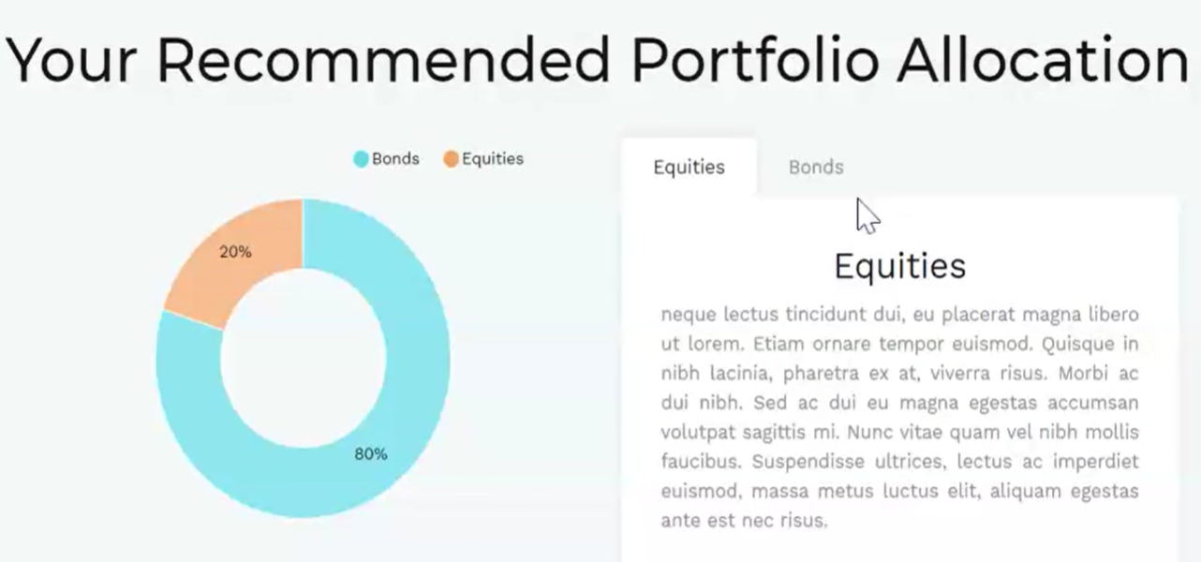
Detailed Analysis of Solution (cont.)
The system then aids users in selecting both bonds and stocks, but most features focus on the aspect of stock selection.
Asset Selection Process
Social Media Sentiment Indicator
Through stock dashboard, users can access a leading indicator of share prices
Bonds
Stocks
Tesla’s 14 day Average Social Media Sentiment Score vs Stock Price, June 2020 to Present
Compare current bond and fixed deposit yields
Filter S&P500 stocks by our proprietary quality indicator
Quality Indicator: 4 Factors for Long Term Business Success
Business Dynamics
Growth Potential
Gross Profit To Total Asset Ratio
Indicates how efficient a business is at using its assets.
Higher = business needs less capital to grow
Avg. of Past And Future Revenue Growth Rates
Most direct way to indicate the forward growth potential of the business. Higher = more growth potential
01
02
Machine Learning
Investment Decisions
Cyclicality
Prudency
Measure sentiment of social media content, weighted by popularity of content
Based on above trend, positive sentiment tends to build up prior to a significant advancement in share prices
Stock’s
Historical Beta
Indicates how efficient a business is at using its assets.
Higher = business needs less capital to grow
Debt to Market Cap Ratio
Shows the share of debt used to fund the capital structure relative to equity. Lower = less risky
Notes:
Following this, we provide resources to help the user pick specific assets to invest in.
For bonds, a list of links is provided to help users compare current bond and fixed deposit yields. And for stocks, we provide a screener that filters S&P 500 stocks by key metrics like market capitalisation, industry, dividend yield, growth and our proprietary quality indicator.
This quality indicator is underpinned by four factors that support the long term success of businesses: business dynamics, growth potential, cyclicality and prudency, and we have indicators for each of these factors- they are GPTA, revenue growth rates, beta and debt to market cap respectively. For details on why we chose each of these metrics, please refer to the detailed slide deck that we will be submitting separately.
When users click through to the stock dashboard, they can access another leading indicator of share prices, a social media sentiment indicator that is the product of a machine learning tool. It measures the sentiment of social media content, weighted by the popularity of that content. As seen on screen, positive sentiment tends to build up prior to a significant advancement in share prices, supporting the use of this indicator in investment decisions.

Slide 5












Defining the Business Case: How Are We Different From Existing Solutions?
We differ by providing a one-stop service for financial planning, risk tolerance evaluation, and investment selection.
Financial Planning
Evaluating Risk Tolerance
Investment Selection
Existing Solutions
Lots of online information about financial planning
Lack an easy-to-use financial planning tool
Lots of information about different selection methodologies
Easy to get lost without requisite knowledge
Risk assessment tools are available, without specific advice and guidance
Our Solution
One-stop solution for planning of key financial milestones
Recommends a minimum monthly contribution to achieve financial target
We provide a recommended asset equity-bond allocation
Guided by conventional wisdom on asset allocation
We provide a stock screener and resources for bond selection
Business quality score and real-time sentiment score guides investment decisions
Notes:
Next, we believe that our service is superior to existing market tools in the areas of financial planning, risk tolerance and investment selection
In terms of financial planning, a lot of valuable information exists but there is rarely an easy to use financial planning tool. We provide a one-stop solution for financial planning, which simplifies the process significantly by recommending a minimum monthly contribution to achieve their financial target
At the same time, risk assessment checklists are fairly common on the internet, but there is a lack of concrete information on what to do with the results of those checklists. We simplify things by recommending an asset equity-bond allocation based on those risk assessment scores
With investment selection, there are, again, a wealth of resources online about different selection methodologies. However, it is easy to get lost without the requisite knowledge. We provide a stock screener and resources for bond selection, all on one site to simplify that process. In addition, our real-time sentiment score and our proprietary business quality score facilitates users’ investment decisions

Slide 6






Defining the Business Case: User Stickiness & Monetisation
We have incorporated features to keep users engaged, and the platform can be improved further in a monetisation scenario.
Creating a Sticky User Base
Areas of Improvement and Further Monetisation
Several features to keep users engaged
Due to time constraints, unable to deploy all ideas
Forum for interaction between users to improve user stickiness
Portfolio function for users to track real-time portfolio performance
Monthly contribution tracker that denotes whether the user is on-track to reaching their target
User Profile
Daily Updates
Refreshed Scoring
All data is saved in the user’s profile, allowing users to update figures as and when needed
News articles, company metrics and sentiment indicator are updated daily, making site a useful source for regular updates
The quality score is updated when the company releases a new set of financial results, allowing users to monitor their holdings over time
Possible actions to strengthen monetization
Widening the variety of investing styles (beyond just stocks and bonds in general) to accommodate more specific preferences
Partnering financial institutions e.g. brokerages for referral revenue
Notes:
In order to keep users engaged in our platform, we allow users to save all data in their individual “user profile”, allowing them to update figures as and when needed.
News articles, company metrics and the sentiment indicator are also updated daily, making the site a useful source of regular check-in
Same goes for the quality score, which is updated when the company releases a new set of financial results, allowing users to monitor their holdings over time
Due to time constraints, we were unable to deploy all our ideas. Some areas of improvement we could look into are:
A forum for interaction between users to improve user stickiness
A portfolio integration function for users to track real-time portfolio performance
A monthly income contribution tracker that denotes whether the user is on-track to reaching their target
We also thought about
Widening the variety of investing styles (beyond just stocks and bonds in general) to accommodate more specific preference
Partnering with financial institutions such as brokerages for referral revenue

Slide 7











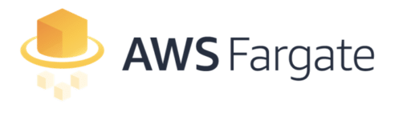
Solution Architecture
User Browser
Amazon RDS Database
External APIs
Stock Price
Stock News
Key Metrics
Social Media Sentiment
HTTP
HTTP
HTTP
Responsive Interface
Backend REST API
HTTP
Web Server
Web Server
Container
Container
Scalable Infrastructure

Slide 8



APIs
Bloomberg Market & Financial News API
Yahoo Finance API
News API
A news search API that we use to get stock news
Database updated daily
User refreshes
User refreshes
User refreshes
User Browser
1
2
3
4
Gross Profit to Total Asset
Beta
Sales Growth
Debt to Market Cap
A machine learning API that scrapes social media posts mentioning the stocks and scores their sentiment based on content, popularity and relevance
User refreshes
Scoring of 1 – 25 given based on ranking in each attribute
Final Score: Sum to max 100
Sentiment API
Notes:
To keep information of stocks updated, we call on a number of APIs. We used Bloomberg and Yahoo Finance API to fetch key financial metrics. These include metrics needed for the four quality indicators mentioned before. The score is aggregated to sum of up to 100 based on ranking.

Slide 9
Thank You

